Slide 1
Excretory physiology

Slide 2
Unit 1

Slide 3
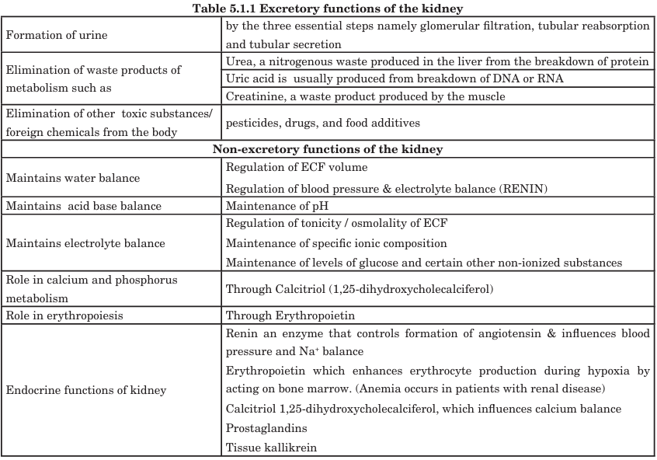

Slide 4
Structure of kidney
1. External Structure
Shape & Size:
  Bean-shaped, ~10–12 cm long, 5–7 cm wide, 3 cm thick.
Surfaces:
  Convex lateral surface
  Concave medial surface → contains hilum
Hilum Contents:
  Renal artery (enters)
  Renal vein (exits)
  Ureter (exits)
  Lymphatics and nerves
Capsule:
  Fibrous capsule surrounding the kidney provides protection.

Slide 5
Structure of kidney
2. Internal Structure
The kidney has two main regions:
a. Cortex
Outer region, light red.
Contains:
  Renal corpuscles (glomeruli + Bowman's capsule)
  Proximal and distal convoluted tubules
Cortical columns (columns of Bertini): Extensions of cortex between pyramids.
b. Medulla
Inner region, darker, triangular structures called renal pyramids.
Pyramids have:
  Base: Faces cortex
  Apex (papilla): Projects into minor calyx
Contains:
  Loops of Henle
  Collecting ducts
c. Pelvis
Funnel-shaped cavity in hilum.
Receives urine from major calyces (formed by minor calyces) → drains into ureter.

Slide 6
Structure of nephron
A nephron consists of two main parts:
A. Renal Corpuscle (for filtration)
Glomerulus
  Network of fenestrated capillaries.
  Receives blood via afferent arteriole, exits via efferent arteriole.
  High pressure → drives filtration of plasma.
Bowman’s Capsule
  Double-walled epithelial cup surrounding glomerulus.
  Parietal layer: outer layer
  Visceral layer: podocytes that wrap around glomerular capillaries
  Capsular space collects filtrate from blood.

Slide 7
Structure of nephron
B. Renal Tubule (for reabsorption & secretion)
Proximal Convoluted Tubule (PCT)
  Located in cortex.
  Microvilli → large surface area.
  Functions: reabsorption of glucose, amino acids, sodium, water, bicarbonate; secretion of drugs & hydrogen ions.
Loop of Henle
  Descending limb: permeable to water → water reabsorption
  Ascending limb: impermeable to water → Na⁺, K⁺, Cl⁻ reabsorption
  Creates medullary osmotic gradient for urine concentration.
Distal Convoluted Tubule (DCT)
  Located in cortex.
  Functions: regulated reabsorption of Na⁺, Ca²⁺ (under aldosterone & PTH), secretion of K⁺, H⁺.
Collecting Duct
  Receives urine from multiple nephrons.
  Functions: water reabsorption (regulated by ADH), final urine concentration, secretion of H⁺ and K⁺.

Slide 8
Functions of nephron
Segment | Major Function
Glomerulus | Filtration of plasma (water, solutes)
Bowman’s capsule | Collects filtrate
PCT | Reabsorbs ~65% of water, Na⁺, glucose, amino acids; secretes H⁺ & drugs
Loop of Henle | Concentrates urine; Na⁺ & water reabsorption
DCT | Fine-tuning of electrolytes & pH; hormone-regulated reabsorption
Collecting duct | Water reabsorption (ADH); final urine composition; acid-base balance

Slide 9
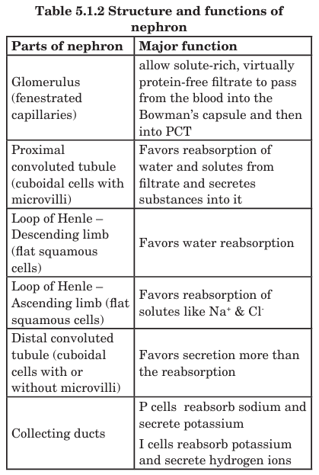

Slide 10
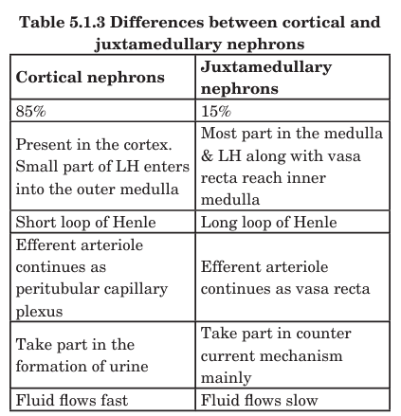

Slide 11
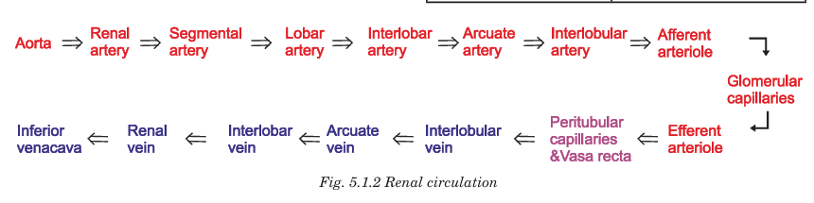

Slide 12
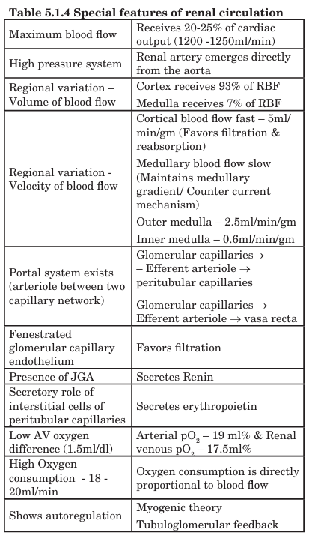

Slide 13
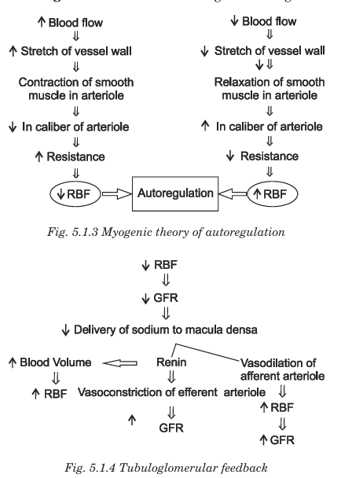

Slide 14
Juxtaglomerular Apparatus (JGA)
Components of JGA
Juxtaglomerular (JG) Cells
  Modified smooth muscle cells of the afferent arteriole (sometimes efferent).
  Function:
    Secrete renin in response to low blood pressure, sympathetic stimulation, or low sodium delivery to DCT.
Macula Densa
  Specialized epithelial cells of the distal convoluted tubule that contact the afferent arteriole.
  Function:
    Sense Na⁺ and Cl⁻ concentration in tubular fluid.
    Signal JG cells to release renin if Na⁺ is low.
Extraglomerular Mesangial Cells (Lacis Cells)
  Located between afferent and efferent arterioles and macula densa.
  Function:
    Support structure
    Facilitate signal transmission between macula densa and JG cells

Slide 15
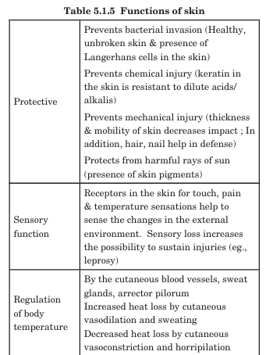
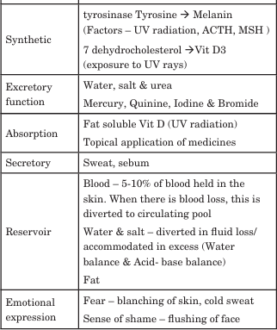
Func of skin

Slide 16
Unit 2

Slide 17
Glomerular filtration rate
GFR is the volume of fluid filtered by both kidneys per unit time through the glomeruli. It is a key indicator of kidney function.
Parameter | Normal Range
GFR (both kidneys) | 90–120 mL/min/1.73 m²
GFR (per kidney) | ~45–60 mL/min
GFR (per nephron, single nephron GFR) | ~30–80 nL/min

Slide 18
Factors influencing GFR
GFR depends on glomerular hydrostatic and osmotic forces as described by Starling’s equation:
GFR = Kf × [(P_GC – P_BS) – (π_GC – π_BS)]
Kf: Filtration coefficient (surface area × permeability)
P_GC: Glomerular capillary hydrostatic pressure
P_BS: Bowman's space hydrostatic pressure
π_GC: Glomerular capillary oncotic pressure
π_BS: Bowman's space oncotic pressure (usually ~0)

Slide 19
Factors influencing GFR
A. Hemodynamic Factors
Glomerular capillary hydrostatic pressure (P_GC)
  High pressure → ↑ GFR
  Controlled by afferent/efferent arteriole tone
Bowman’s space hydrostatic pressure (P_BS)
  High tubular pressure → ↓ GFR
  Example: obstruction in ureter
Plasma oncotic pressure (π_GC)
  High plasma proteins → ↓ GFR (opposes filtration)
Filtration surface area & permeability (Kf)
  Glomerular damage → ↓ Kf → ↓ GFR

Slide 20
Factors influencing GFR
B. Neural & Hormonal Factors
Sympathetic stimulation
  Constricts afferent arterioles → ↓ GFR
Renin–angiotensin–aldosterone system
  Angiotensin II constricts efferent arteriole → maintains GFR in low BP
Prostaglandins
  Vasodilate afferent arteriole → ↑ GFR

Slide 21
Factors influencing GFR
C. Other Factors
Plasma volume: ↑ volume → ↑ GFR
Age: GFR declines with age
Diseases: Diabetes, hypertension, glomerulonephritis can alter GFR

Slide 22
Applied aspects
Capillary hydrostatic pressure variations occur when there are changes in systemic blood pressure and when there is constriction of afferent or efferent arteriole. These conditions affect the GFR. Colloidal osmotic pressure changes may occur in dehydration and malnutrition (hypoproteinemia) which in turn may affect the GFR. Hydrostatic pressure changes in Bowman’s space when there is either ureteral obstruction or edema of the kidney which in turn may reduce the GFR. Any condition that alters the filtration surface will also affect the GFR

Slide 23
Unit 3

Slide 24
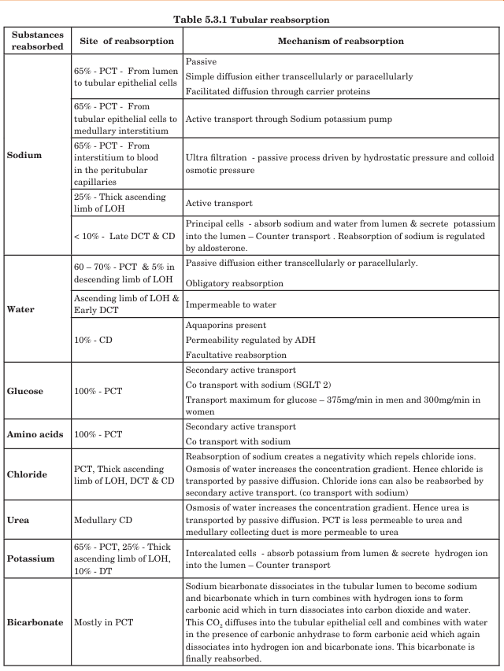

Slide 25
Tubular Reabsorption
Tubular reabsorption is the process by which substances are moved from the tubular fluid (filtrate) back into the blood (peritubular capillaries).
Nephron Segment | Reabsorbed Substances | Mechanism / Notes
Proximal Convoluted Tubule (PCT) | ~65% Na⁺, water, Cl⁻, K⁺, HCO₃⁻, glucose, amino acids | Active Na⁺ transport drives water reabsorption (osmosis); Na⁺-glucose cotransport; isosmotic reabsorption
Loop of Henle | Descending: water | Water reabsorption (impermeable to solutes)
 | Ascending: Na⁺, K⁺, Cl⁻ | Active transport; impermeable to water → dilutes tubular fluid
Distal Convoluted Tubule (DCT) | Na⁺, Cl⁻, Ca²⁺ | Na⁺ reabsorption via Na⁺-Cl⁻ symporter; Ca²⁺ under PTH control
Collecting Duct | Water, Na⁺, urea | Water reabsorption via ADH; Na⁺ via aldosterone; urea recycling aids medullary concentration

Slide 26
Tubular secretion
Tubular secretion is the transfer of substances from peritubular capillaries into the tubular fluid.
Nephron Segment | Secreted Substances | Function / Notes
PCT | H⁺, NH₄⁺, creatinine, drugs | Acid-base balance; drug elimination
DCT | K⁺, H⁺ | K⁺ secretion under aldosterone; H⁺ secretion for pH regulation
Collecting Duct | H⁺, K⁺, NH₄⁺ | Acid-base balance; final urine composition

Slide 27
Unit 4

Slide 28
Counter current system
The counter-current system in the kidney refers to the arrangement of the loop of Henle and vasa recta, which allows the concentration of urine by creating and maintaining a medullary osmotic gradient.
Found mainly in juxtamedullary nephrons (long loops of Henle).
Essential for water conservation and producing hyperosmotic urine.
Components
Loop of Henle (Tubular Counter-Current)
  Descending limb: Permeable to water, impermeable to solutes.
  Ascending limb: Impermeable to water, actively transports Na⁺, K⁺, Cl⁻ out → dilutes tubular fluid.
Vasa Recta (Blood Counter-Current)
  Straight capillaries surrounding loop of Henle.
  Blood flows opposite to tubular fluid → prevents washout of medullary osmotic gradient.

Slide 29
Counter current mechanism
Stepwise Mechanism:
Active solute transport in ascending limb
  Na⁺, K⁺, Cl⁻ actively pumped into medulla
  Ascending limb is impermeable to water → tubular fluid becomes dilute
Water movement in descending limb
  Descending limb is permeable to water
  Water moves out into hyperosmotic medullary interstitium → tubular fluid becomes concentrated
Flow maintains gradient
  Tubular fluid moves down descending limb → concentrates
  Fluid moves up ascending limb → dilutes
  Gradient multiplies along the length of the loop → “multiplication” effect.

Slide 30
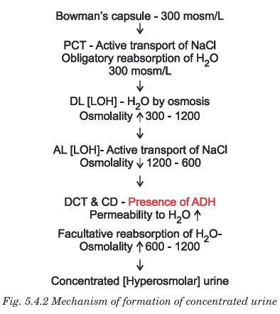

Slide 31
Applied aspects
The key step is the active transport of NaCl out of the ascending limb. If this is abolished, eg., by use of the diuretic frusemide, all concentration differences are lost and the kidney can only produce isotonic urine. Nephrogenic diabetes insipidus is the inability of the kidney to respond to ADH. It could be due to mutation of the gene for V2 receptor or the gene for aquaporin-2. Mannitol and related polysaccharides which are filtered but not reabsorbed cause osmotic diuresis

Slide 32
Unit 5

Slide 33
Acid base balance
Acid-base balance is the regulation of hydrogen ion (H⁺) concentration in body fluids to maintain a normal blood pH of 7.35–7.45, essential for enzyme function and cellular activity.
Source | Examples
Metabolic acids | CO₂ (from respiration → H₂CO₃), lactic acid, ketoacids, phosphoric & sulfuric acids
Bases | HCO₃⁻ (bicarbonate), proteins, phosphate buffers

Slide 34
Buffer Systems (Immediate Defense)
Buffers: Substances that resist pH changes by binding or releasing H⁺.
Bicarbonate Buffer (Extracellular)
  HCO₃⁻ + H⁺ ↔ H₂CO₃ ↔ CO₂ + H₂O
  Main extracellular buffer
  Works rapidly (seconds to minutes)
Phosphate Buffer (Intracellular & Urine)
  HPO₄²⁻ + H⁺ ↔ H₂PO₄⁻
  Important in renal tubular fluid
Protein Buffer (Intracellular)
  Proteins like hemoglobin bind H⁺ via amino acid side chains
  Important in red blood cells

Slide 35
Respiratory Regulation (Minutes)
CO₂ + H₂O ↔ H₂CO₃ ↔ H⁺ + HCO₃⁻ (catalyzed by carbonic anhydrase)
Mechanism: Lungs control CO₂ elimination → affects blood pH.
  Hyperventilation → ↓ CO₂ → ↑ pH (respiratory alkalosis)
  Hypoventilation → ↑ CO₂ → ↓ pH (respiratory acidosis)

Slide 36
Renal Regulation (Hours to Days)
Kidneys regulate H⁺ and HCO₃⁻ excretion/absorption.
Mechanisms:
Bicarbonate Reabsorption (mainly PCT & collecting duct)
  HCO₃⁻ reabsorbed → maintains extracellular buffer
Hydrogen Ion Secretion
  H⁺ secreted into tubular fluid (PCT, DCT, collecting duct)
  Buffers: phosphate, ammonia
Generation of New Bicarbonate
  From metabolism of glutamine → NH₄⁺ + HCO₃⁻
Result: Slow but powerful correction of metabolic acid-base disorders.

Slide 37
Normal parameters
Parameter | Normal Range
Arterial pH | 7.35–7.45
HCO₃⁻ | 22–26 mEq/L
PaCO₂ | 35–45 mmHg

Slide 38
Applied aspects
Disorders of Acid-Base Balance
Type | Primary Disturbance | Examples
Respiratory acidosis | ↑ PaCO₂ | Hypoventilation, COPD
Respiratory alkalosis | ↓ PaCO₂ | Hyperventilation, anxiety
Metabolic acidosis | ↓ HCO₃⁻ | Diabetic ketoacidosis, renal failure, diarrhea
Metabolic alkalosis | ↑ HCO₃⁻ | Vomiting, diuretics, excessive antacids

Slide 39
Unit 6

Slide 40
Micturition
Micturition is the process of urine expulsion from the urinary bladder through the urethra. It involves coordinated activity of the bladder muscles, sphincters, and nervous system.
Micturition involves two phases: storage (continence) and voiding (urination).
A. Storage Phase
Detrusor muscle: Relaxed
Internal sphincter: Contracted
External sphincter: Contracted voluntarily
Nervous control: Sympathetic dominance → promotes storage

Slide 41
Neural control
Phase | Nerve Activity | Muscle Action
Storage | Sympathetic (hypogastric), Somatic (pudendal) | Detrusor relaxed, sphincters contracted
Micturition | Parasympathetic (pelvic), voluntary inhibition lifted | Detrusor contracts, sphincters relax

Slide 42
Micturition reflex
The micturition reflex is an autonomic spinal reflex that causes contraction of the urinary bladder (detrusor muscle) and relaxation of the internal urethral sphincter, resulting in urine expulsion.

Slide 43
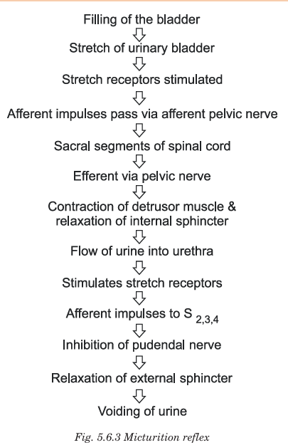

Slide 44
Applied aspects
Condition | Cause | Effect
Atonic bladder | Spinal cord injury destroying sacral segments | Loss of reflex → urinary retention + overflow
Automatic bladder | Spinal cord transection above sacral region | Reflex returns but without voluntary control
Neurogenic overactive bladder | Detrusor overactivity | Frequent urge, incontinence
Stress incontinence | Weak sphincter muscles | Leakage during cough/laugh/sneezing

